Slide 1
Inside Baseball Wireframe
Metadata Crosswalk: LC-DublinCore-NMAAHC

Slide 2
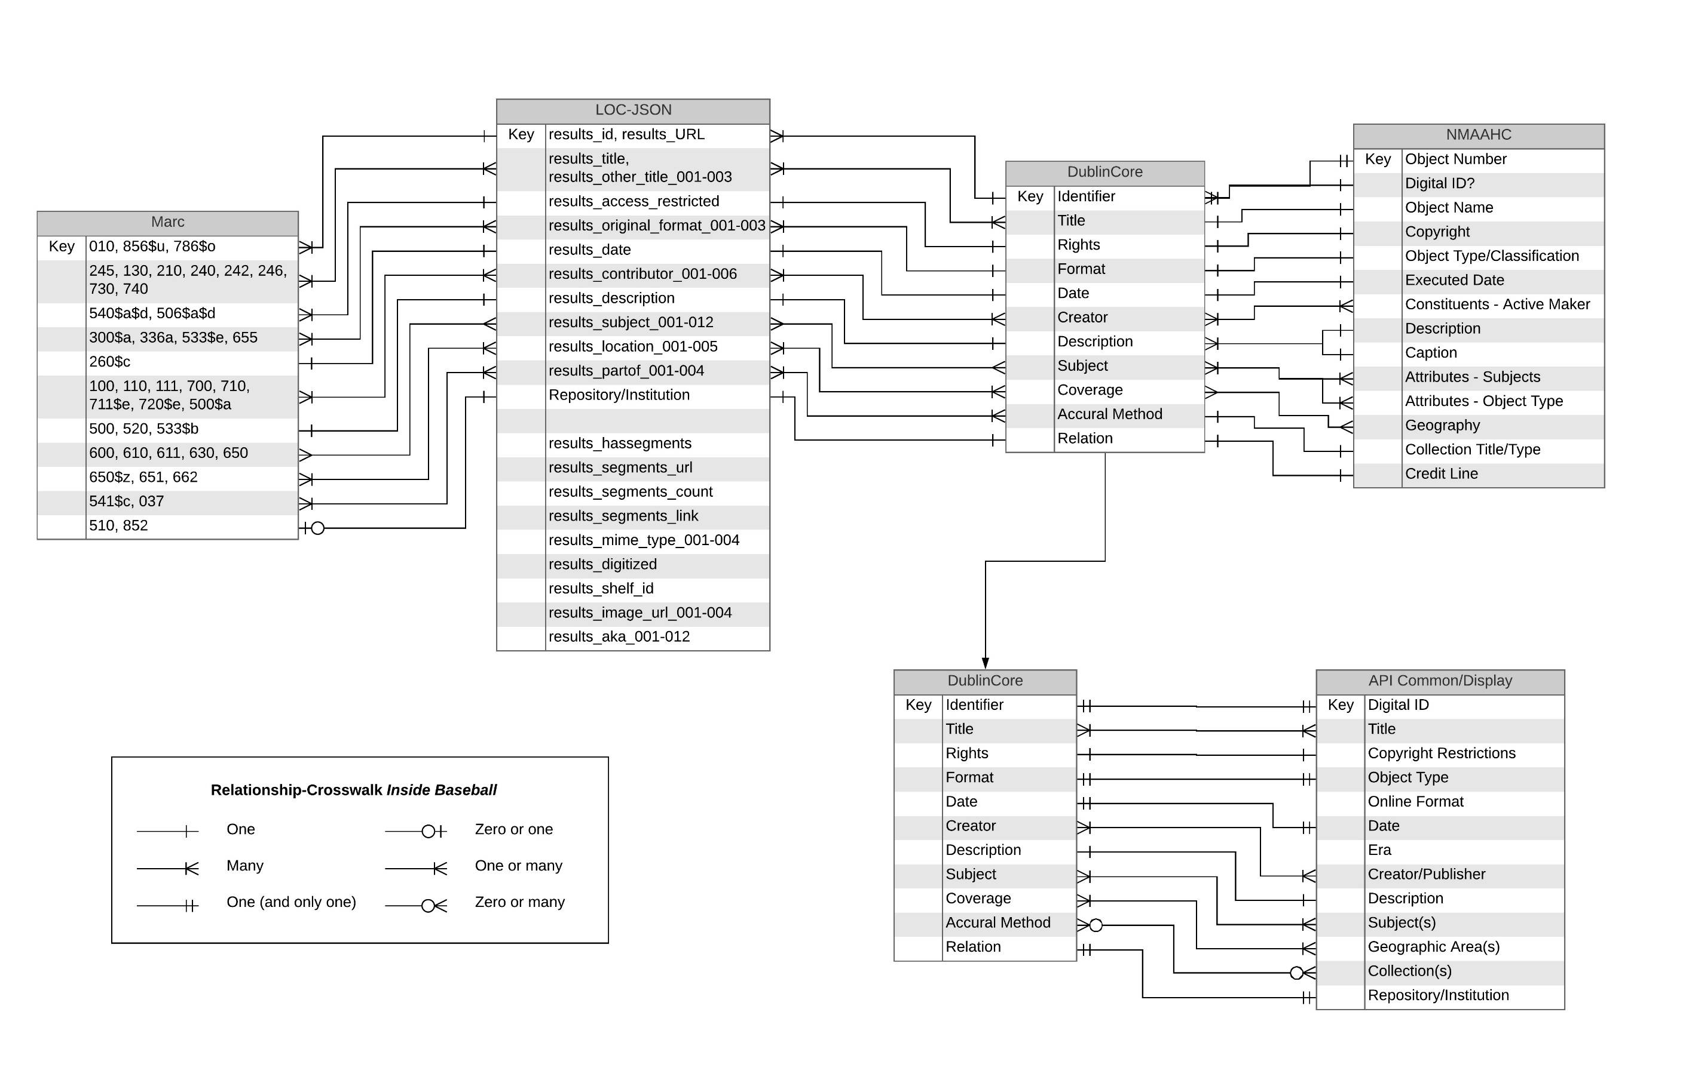

Slide 3
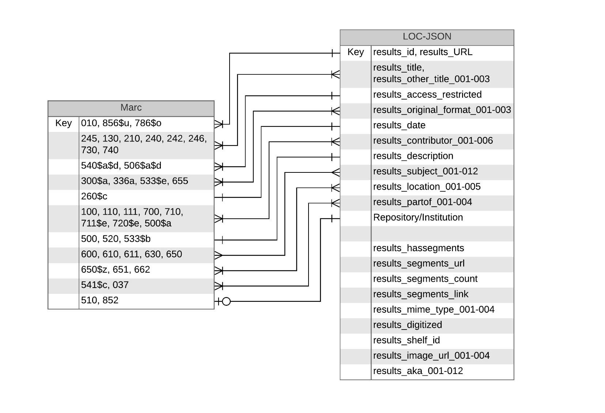

Slide 4
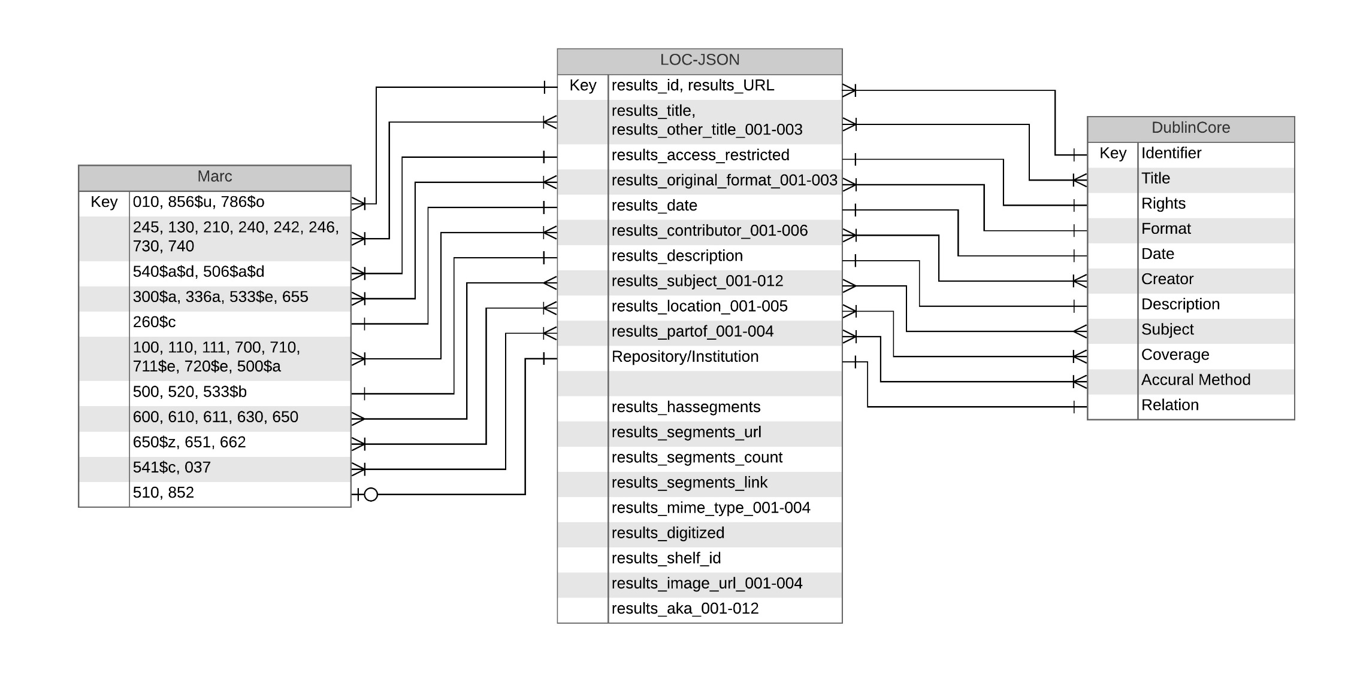

Slide 5
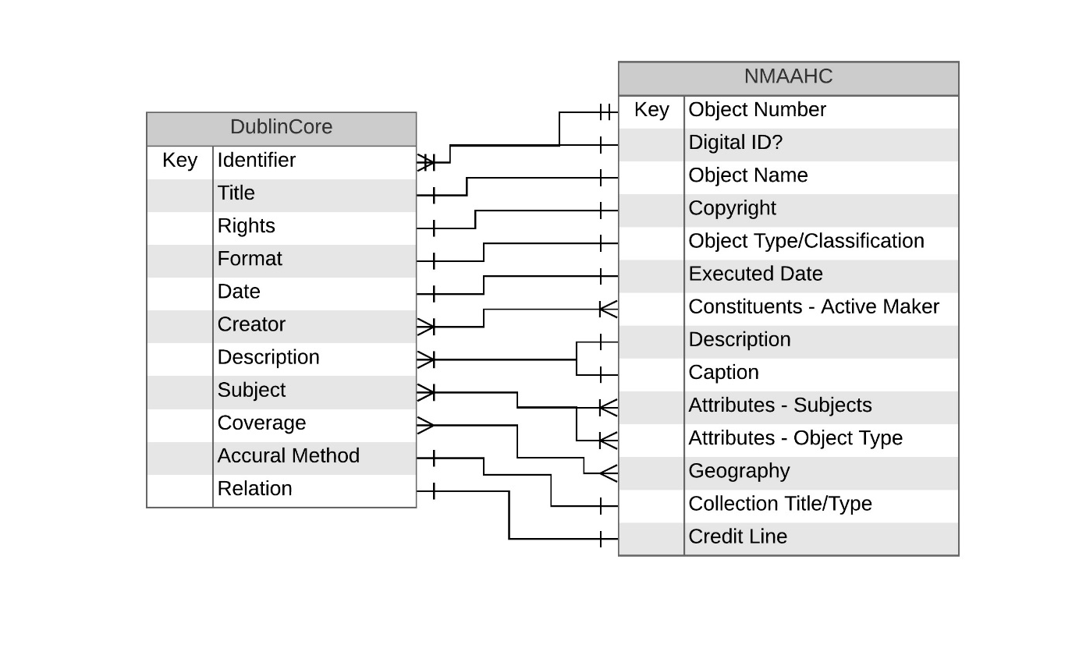

Slide 6
